Slide 1

FORECASTING INFLATION RATE IN HAITI
A MACHINE LEARNING APPROACH
By Chasnick DESIR © September 24, 2021

Slide 2
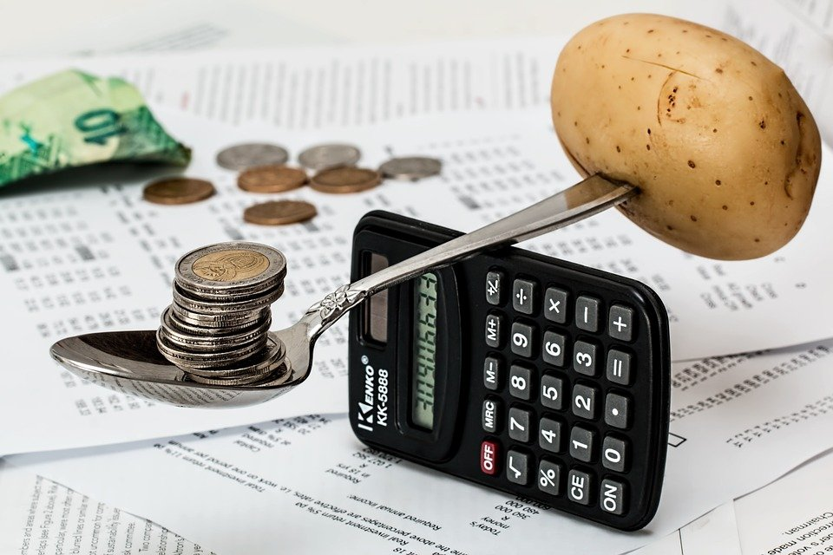
PLAN
INTRODUCTION
METHODOLOGY
DATA SOURCES
QUICK FACTS & FIGURES
IMPACT OF VARIOUS FACTORS
FORECASTING THE INFLATION RATE
COMPARISONS OF DIFFERENTS FORECASTING MODELS
CONCLUSIONS & RECOMMENDATIONS
THANKS, ANNEXES & REFERENCES

Slide 3
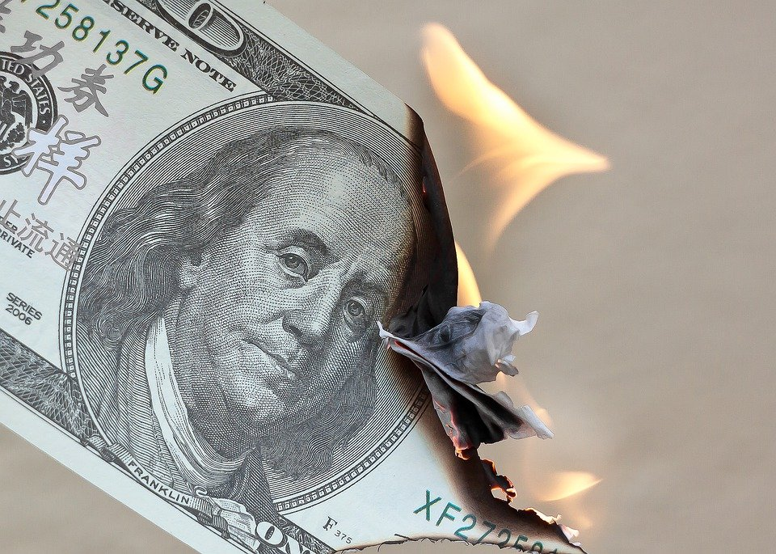
INTRODUCTION
Not a day goes by without variations in the prices of consumer products. As a data analyst, my project is to understand the underlying mechanisms of these fluctuations, to use machine learning models to predict the future evolution of the inflation rate in order to be able to try out corrective measures to stabilize prices.

Slide 4
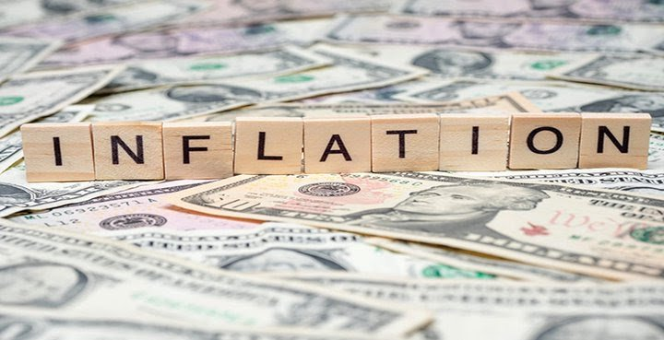
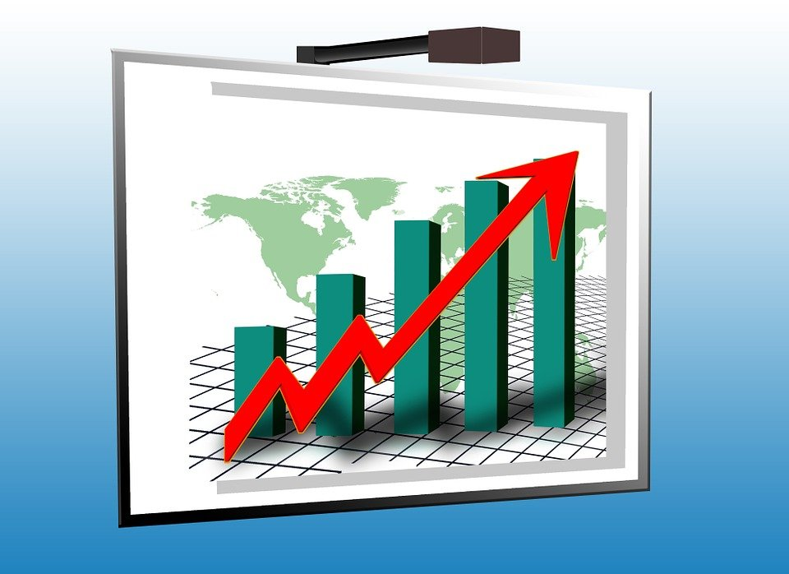
METHODOLOGY
Methodologically the work is based on fisher's theories, quantitative theories of money, the work of Cristiano.
Then a Data Science approach is used to implement different prediction models (AR, ARDL...)
Similar studies have been conducted in Brazil and in the European Union and have helped me to select the independent variables capable of explaining the variation of inflation.

Slide 5
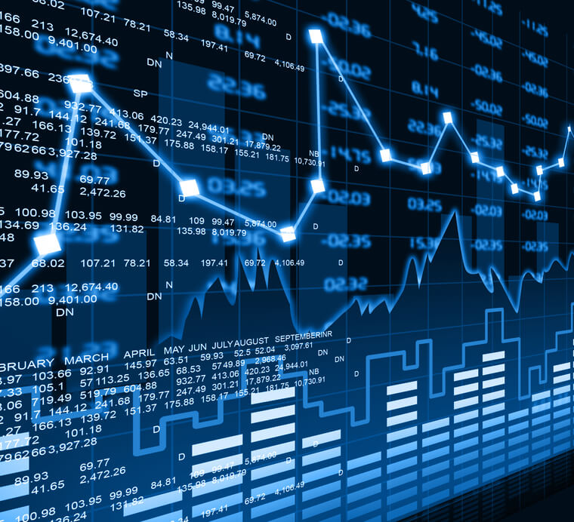
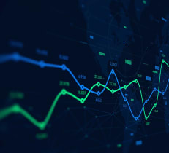
DATA
SOURCES: Haiti Open Data’s website, Haiti’s Central Bank (BRH).
FEATURES: Exchange Rate (‘ChangeRate’), Inflation Rates (‘InflationRate’), Haiti’s Exports (‘IMP_HT’), Policies Rate(“PoliciesRate”), Haiti’s imports (‘EXP_HT’),Monetary Mass(“M3’).

Slide 6


SOME QUICK FACTS & FIGURES
Did you know?
The USA is the first and the main partner of Haiti.
We export the most to them, we import the most from them.
76% of Haiti’s Production is imputable to International Trade.
84% of Haiti’s Exports go to the USA.
20.7% of Haiti’s Imports are from the USA.
(World Bank, 2018)

Slide 7


Now let's see the evolution of the different variables that can influence the Inflation Rates.
Now let's see the evolution of the different variables that can influence the Inflation Rates.

Slide 8
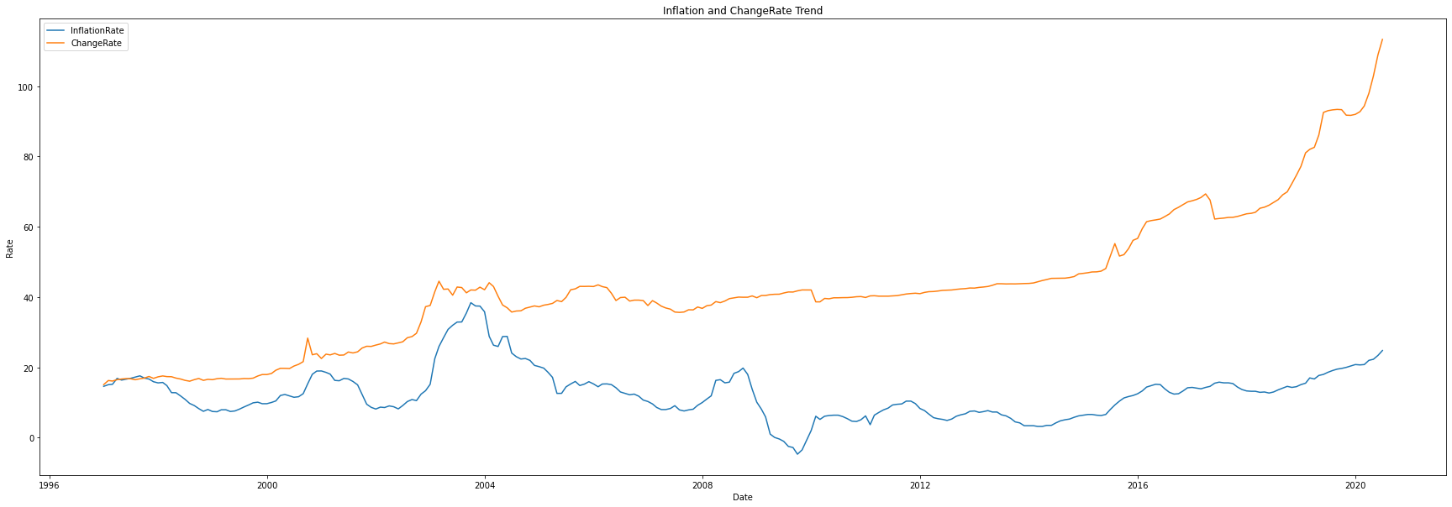
INFLATION
The Exchange rate dramatically increased from around August 2015 thru April 2017. Then from May 2017 to date, it kept on growing exponentially.
As Graph 1 shows it: Inflation varies the same as the exchange rate, those series are very likely to be positively correlated. This is to say that the inflation tends to be high when the Exchange rate is high and vice versa.

Slide 9
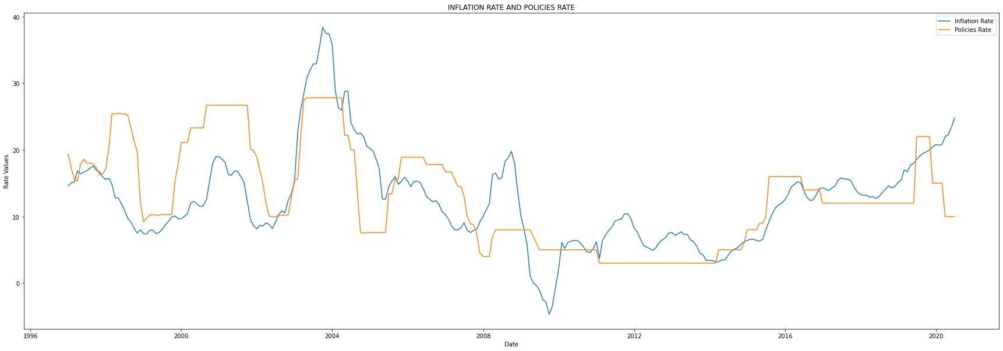
INFLATION
If at certain times there seems to be positive correlations between the policy rate and the inflation rate, at other times there seems to be a disconnect between the fluctuations of the policy rate and the inflation rate, which indicates that external factors influence the inflation rate in these periods. Among these external factors we can mention the protests of 2003 and some peaks of foreign transfers as in 2009.

Slide 10
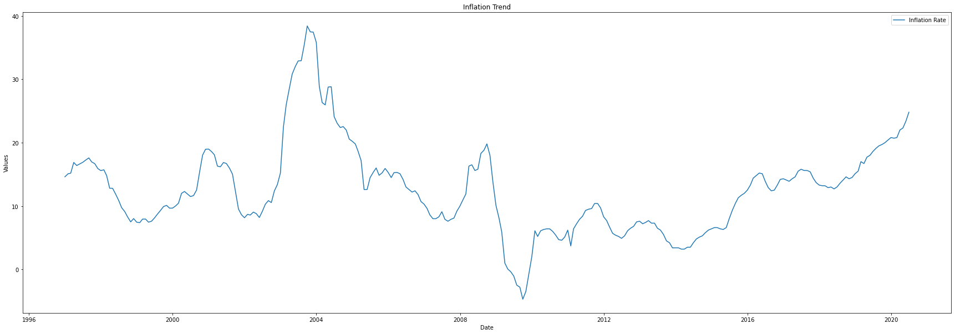
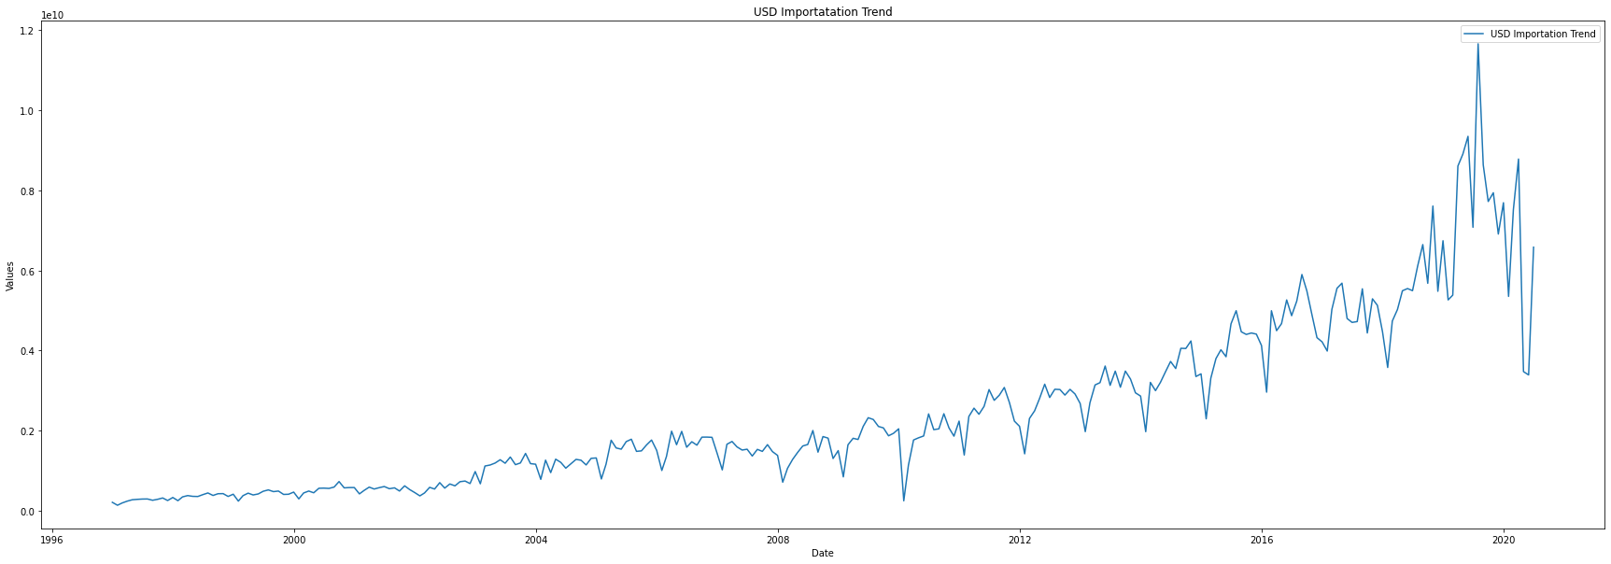
EXPORTS
TO THE USA
The first thing to note is the seasonality in the US Imports. A seasonality is a regularity that happens at the very same period of each period group. For example, the USA imports drops dramatically in January of every year, sometimes down to 20M USD. We can also see some correlation in the upward trends of imports and inflation.

Slide 11
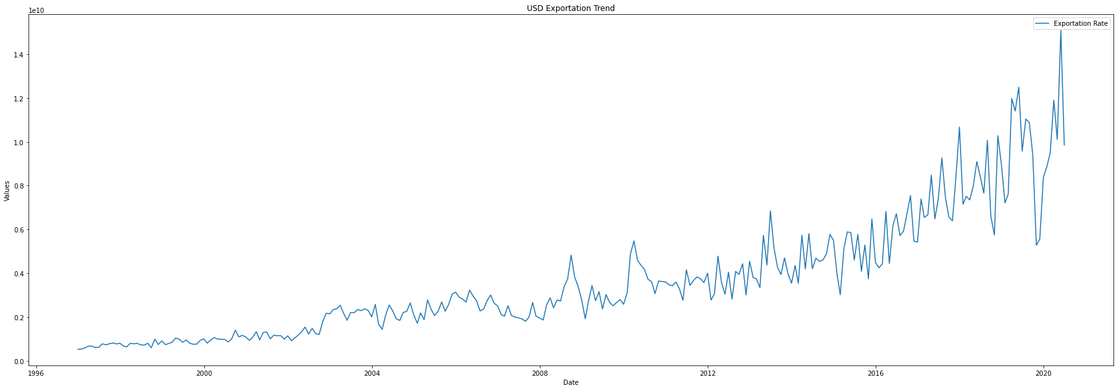
IMPORTS
FROM THE USA
Among other dates alike, in December 2017, the Imports hit a historical high (U$ 160M), but the Inflation Rate did not increase accordingly in the preceding months.
As for the exports, the imports seem to be seized with lows in February. Inflation does not seem to be directly correlated to the level of Haitian imports.
The Inflation rate behaving so weirdly may give the economists reasons to believe that some major agents have the power to influence the price level.

Slide 12
FORECASTING THE INFLATION RATES!

Slide 13


Different models have been developed but only two, the most accurate and robust will be presented.
Model 1 accounts for all the factors analyzed before such as (M3,Policies Rate, Change Rate, Import and Export) and studies their evolution from December 1997 too June 2020.
After different statistical tests, such as the chow test that showed a break in structural parameters in 2003 (following the GNB events and the departure of Aristide) and in 2009 (following the period of post-Preval political instability), it was decided to build model 2.
With Model 2, only the most significant variables (Change Rate and Policies Rate) were kept, and the data used then started in October 2009 to June 2020.

Slide 14
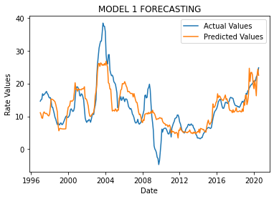
TESTING MODEL 1
Model 1 takes into account the 5 variables and determines an equation
InflationRate= -6.0451 - 0.0539log(M3) + 0.4632*(ChangeRate*100) + 0.5672*(PoliciesRate*100) -0.9359log(IMP_HT) of the dependent variable (Inflation) compared to the lags (level 5) of the other variables.
NB: Log of Variables is taken in Billions of Gourdes.
It has a significant p-value for the 5 variables and an R2 of 0.617.

Slide 15
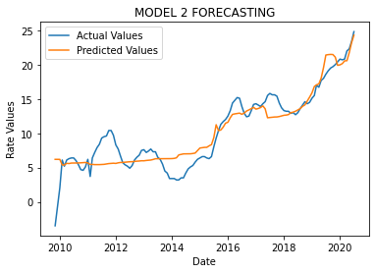
TESTING MODEL 2
Model 2, taking into account only the most significant variables and not including the structural breaks of 2009, produces an equation (InflationRate= -4.812+0.1686(PoliciesRate*100)+0.2419*ChangeRate)).
With an F-statistic of 378 and an R2= 0.857.
It still remains at an acceptable level of accuracy beyond the 6 month forecast..

Slide 16
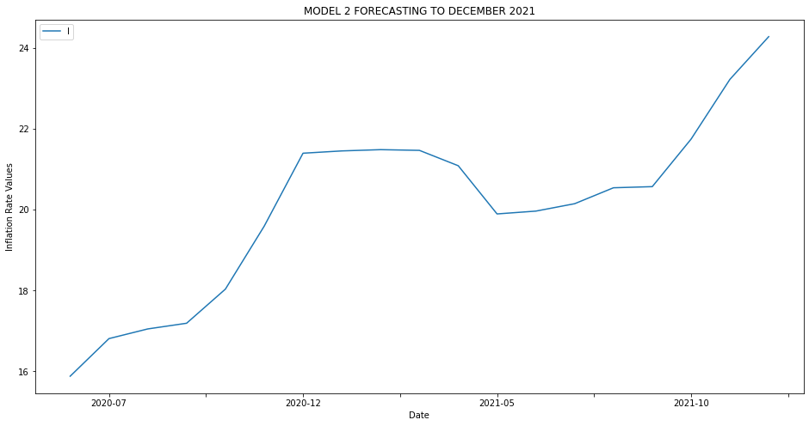
FORECASTING MODEL 2 TO DECEMBER 2021
After the validation of model 2, knowing that the dataset lasted from October 2009 to June 2020, I proceeded to a prediction test until December 2021.
And here are the results:
September 2020: 17.19 %
December 2020: 21.39 %
March 2021: 21.46 %
June 2021: 19.96 %
September 2021: 20.56 %
December 2021: 24.26 %

Slide 17
CONLUSION
The problem ⇨ Inflation Rate constantly increasing.
Economic factors + Non-economic Factors ⇨ 2 models.
Meddling with the market forces?
Model 1 ⇨ Not good enough!
Model 2 ⇨ Good!
Despite the economic information available, the dependent variable (inflation) does not always seem to react as expected. This is certainly the effect of external variables not taken into account by the models. Such as political shocks, natural disasters.

Slide 18
RECOMMENDATIONS TO THE PRIVATE AND PUBLIC SECTOR
It will be necessary to be aware of the risk that an economy undermined by a stagnation of growth combined with a high rate of inflation and unemployment runs.
-A policy of economic recovery should be launched, prioritizing real investment (public infrastructure works, for example).
-A priority fight against insecurity should also be on the agenda of public officials in order to improve the performance of investments, and this should be done within 12 months at the most.
-Lower interest rates for a period of 3 to 5 years on investment loans will support entrepreneurs.
-A policy of long-term financial independence from the United States should be pursued to reduce the sensitivity of the Haitian economy to imported inflation and foreign exchange.
-A limitation of the power of price manipulation of certain actors (large distributors) by reestablishing state-owned warehouses, subject to a balanced and uncorrupted administration of these warehouses.

Slide 19

THANK YOU
Chasnick DESIR
Data Analyst
Business Manager
chasnickdesir@gmail.com
Github link to this project:
https://github.com/ChasnickDesir1995/Capstone-AyitiAnalytics.git
THANK YOU FOR FOLLOWING

